Slide 1

Application Serli Kopar for Specialist RNA Manufacturing Data Science
10.12.24

Slide 2
Structure of presentation
Short Self-Introduction
Demo Project Showcase

Slide 3


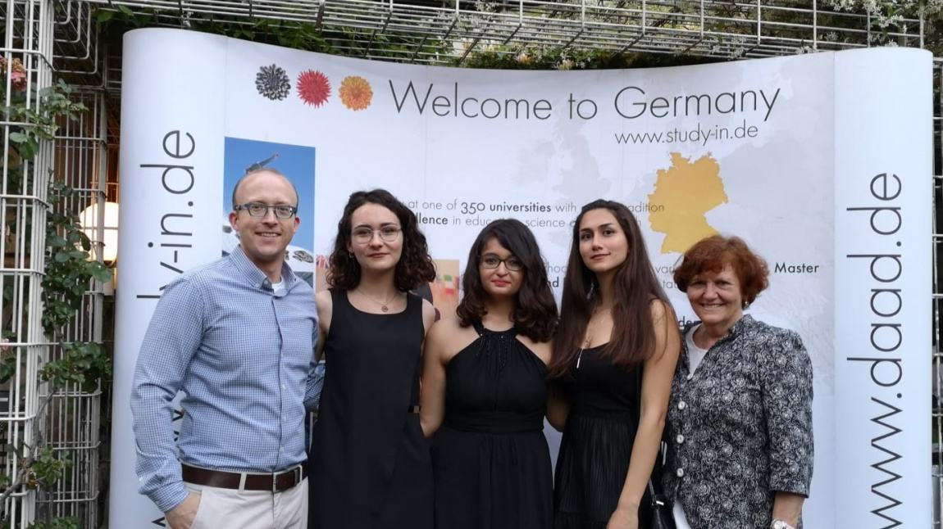




Journey to gERMANY
https://stock.adobe.com/de/images/the-cartoon-character-of-the-cute-covid-19-virus/332757292

Slide 4
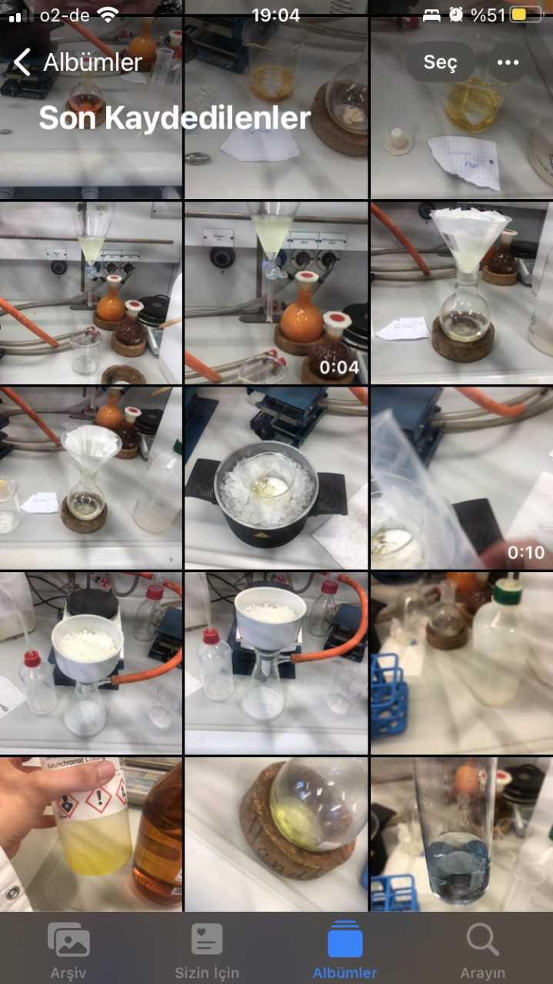
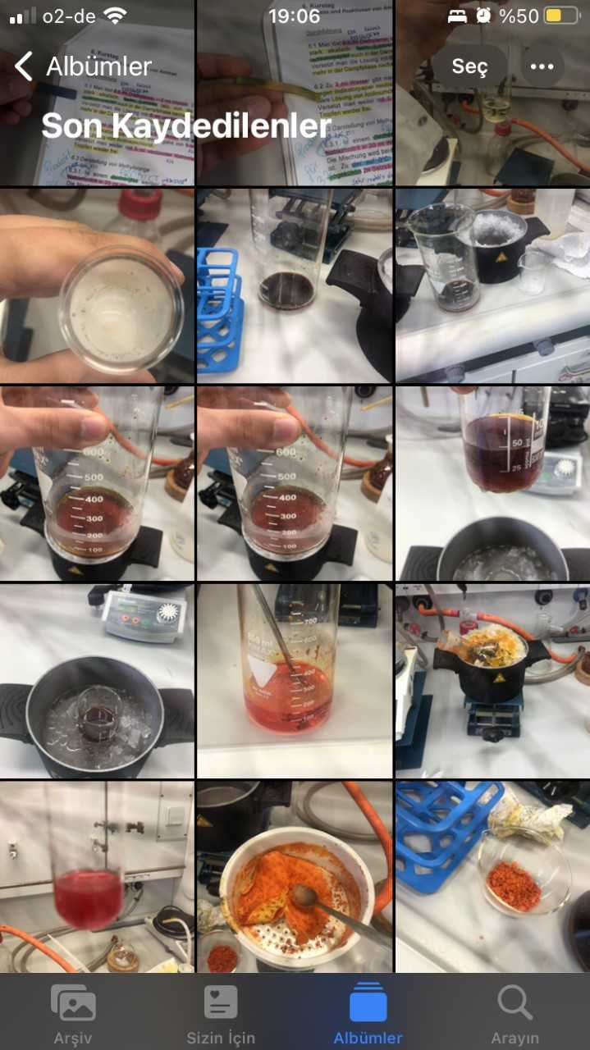
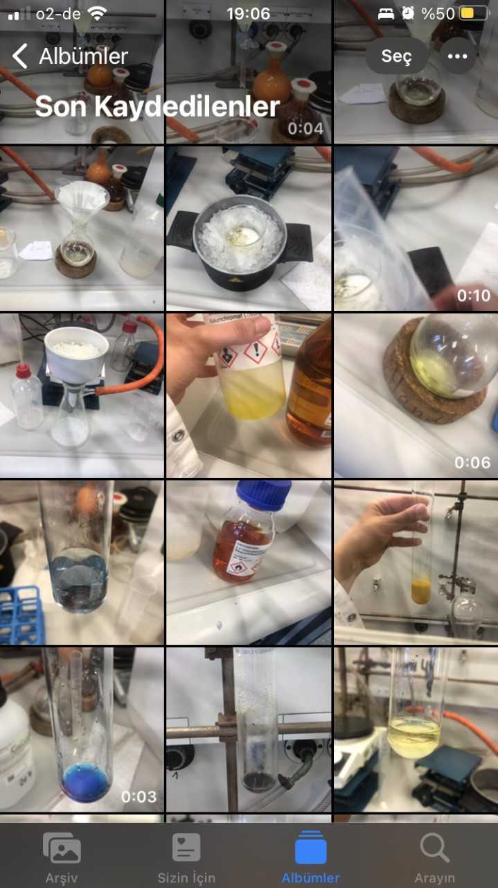
Only from one internship

Slide 5
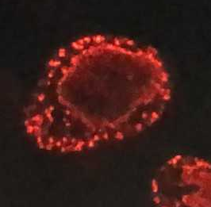
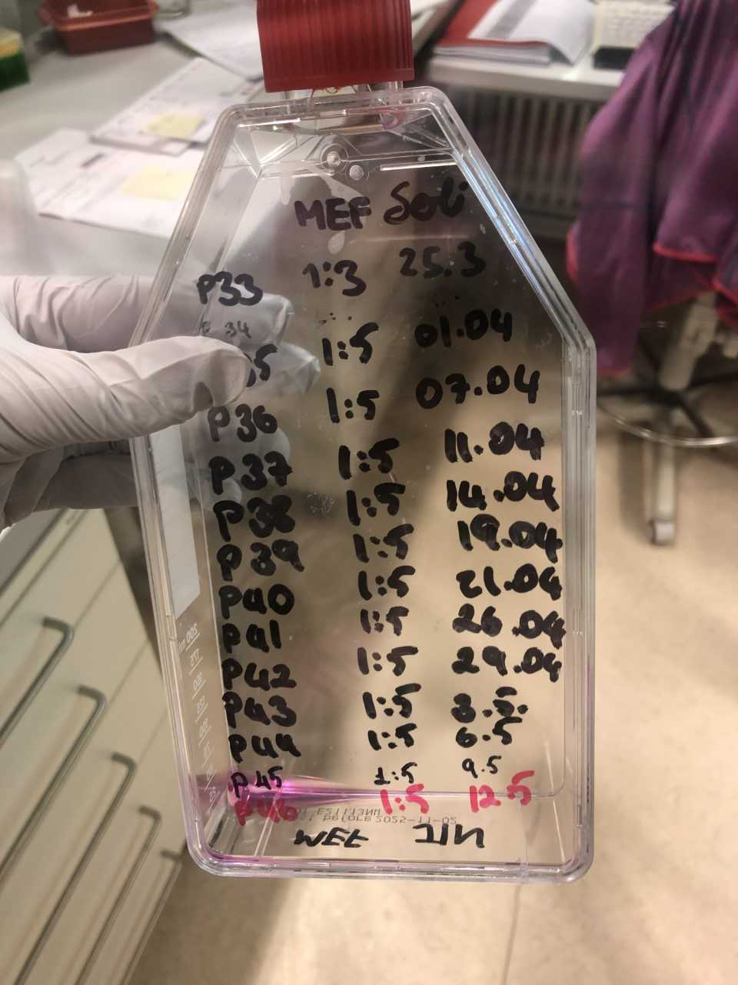
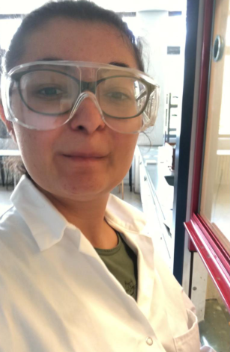
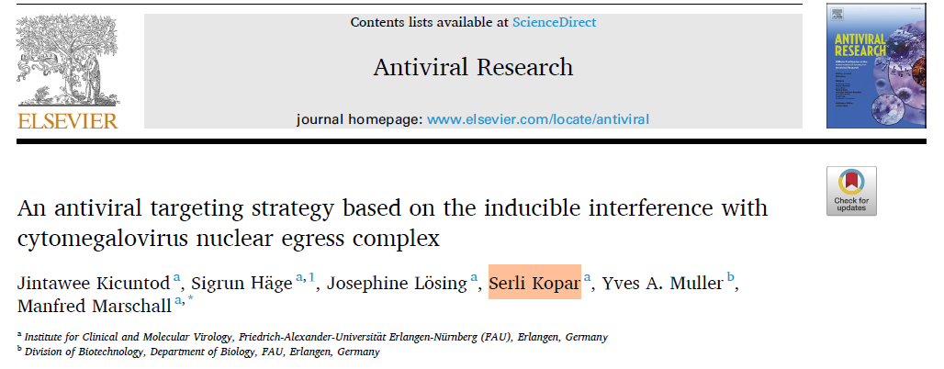







Molecular Medicine b.sc.
2020
Student Research Assistant
Internship Rotations
2021
European Engineering Learning Innovation
Studenten bilden Schüler
2022
Bachelor’s Thesis
Teaching Assistant
Student Lab Assistant
Research Data Analyst
First international political student organisation
Molecular Medicine Studies
Oncology vs Virology
Neurology & Bioinformatics
Foreign Language Studies

Slide 6
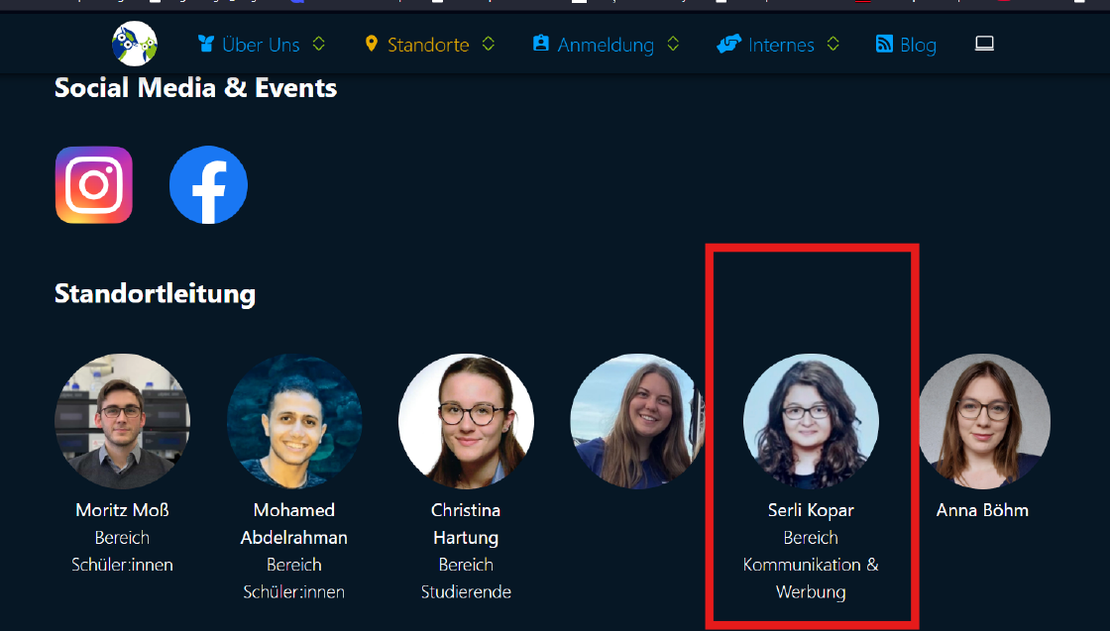
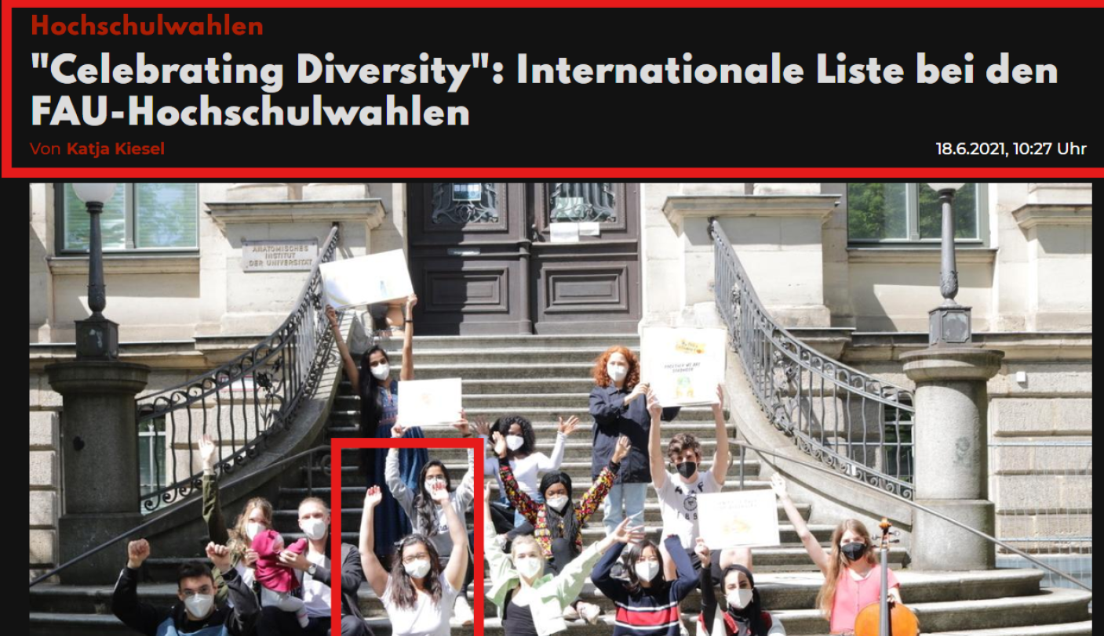
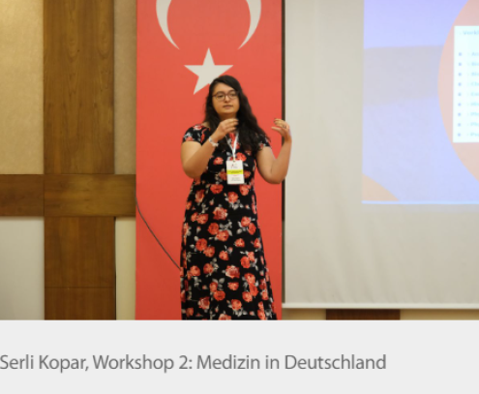
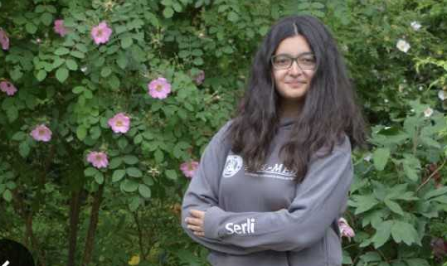
Molecular Medicine b.sc.

Slide 7







FOKUS Life Sciences m.sc. – CS m.Sc.
2023
Diagnostic’s Lab
Teaching Assistant
2024
AI Tutor
2025
Continuation of 1 role
Internship Rotations
Master’s Thesis
Junior Machine Learning Engineer
Junior Conversational AI Engineer
Scientific Collaboration
Job Start
6 months medical leave

Slide 8
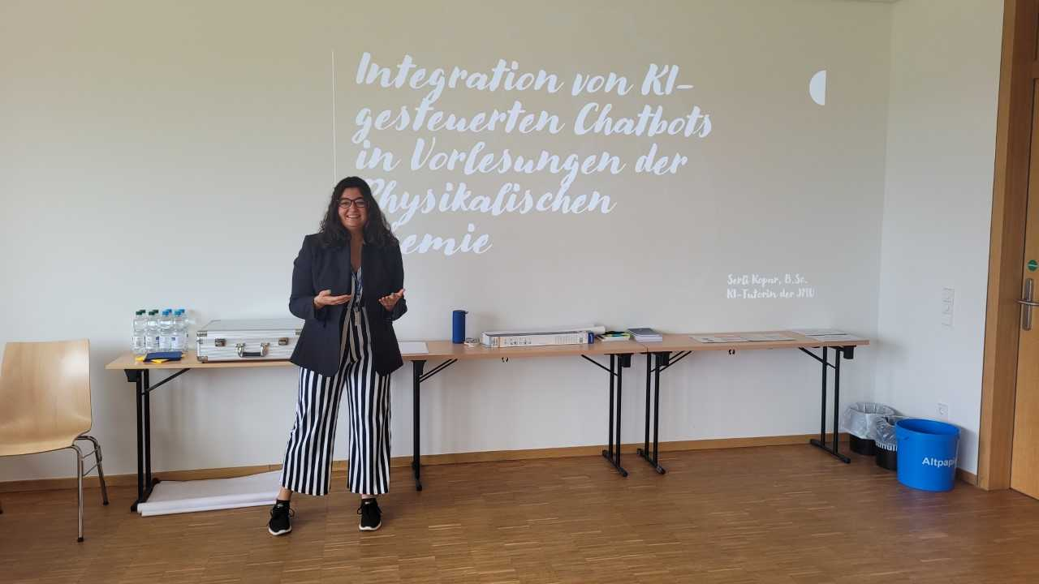
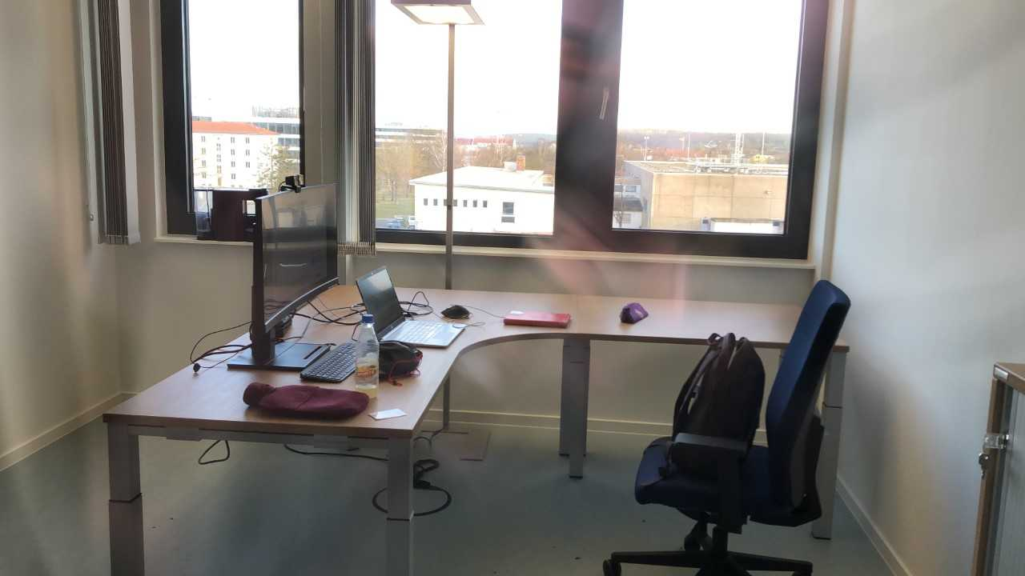
FOKUS Life Sciences m.sc. – CS m.Sc.
Accepting 5-8 Students per year

Slide 9
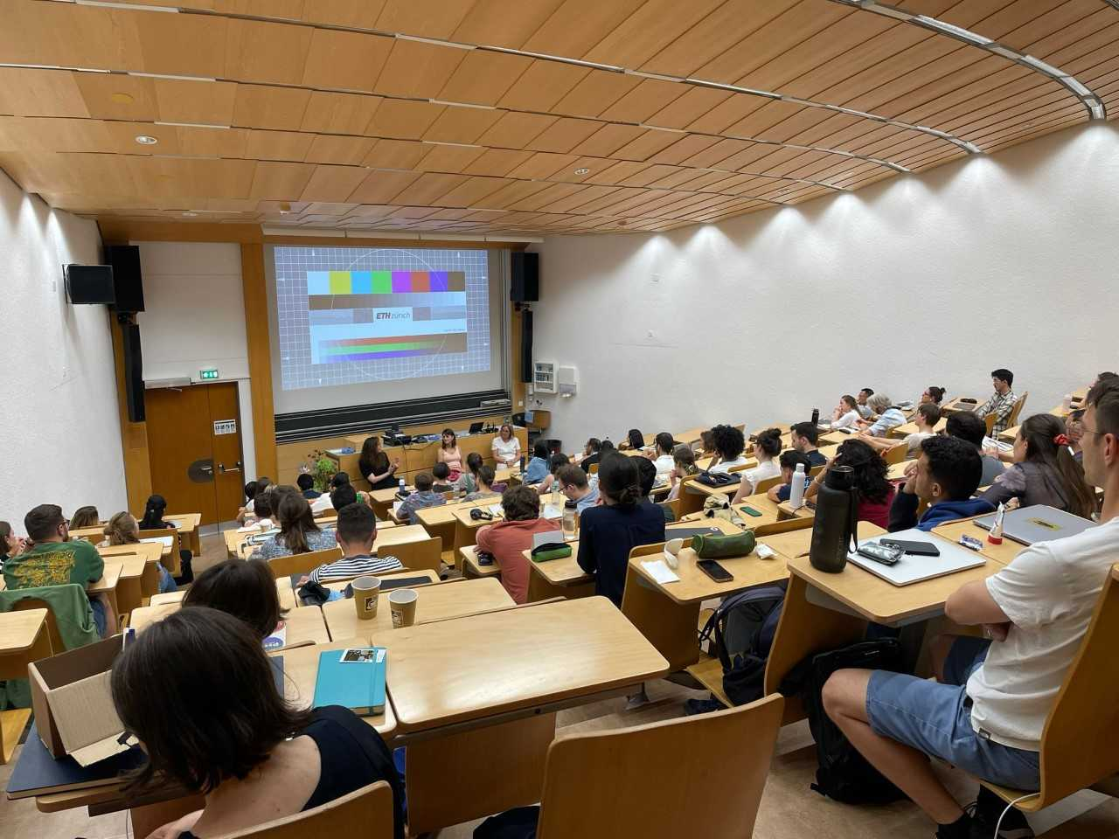
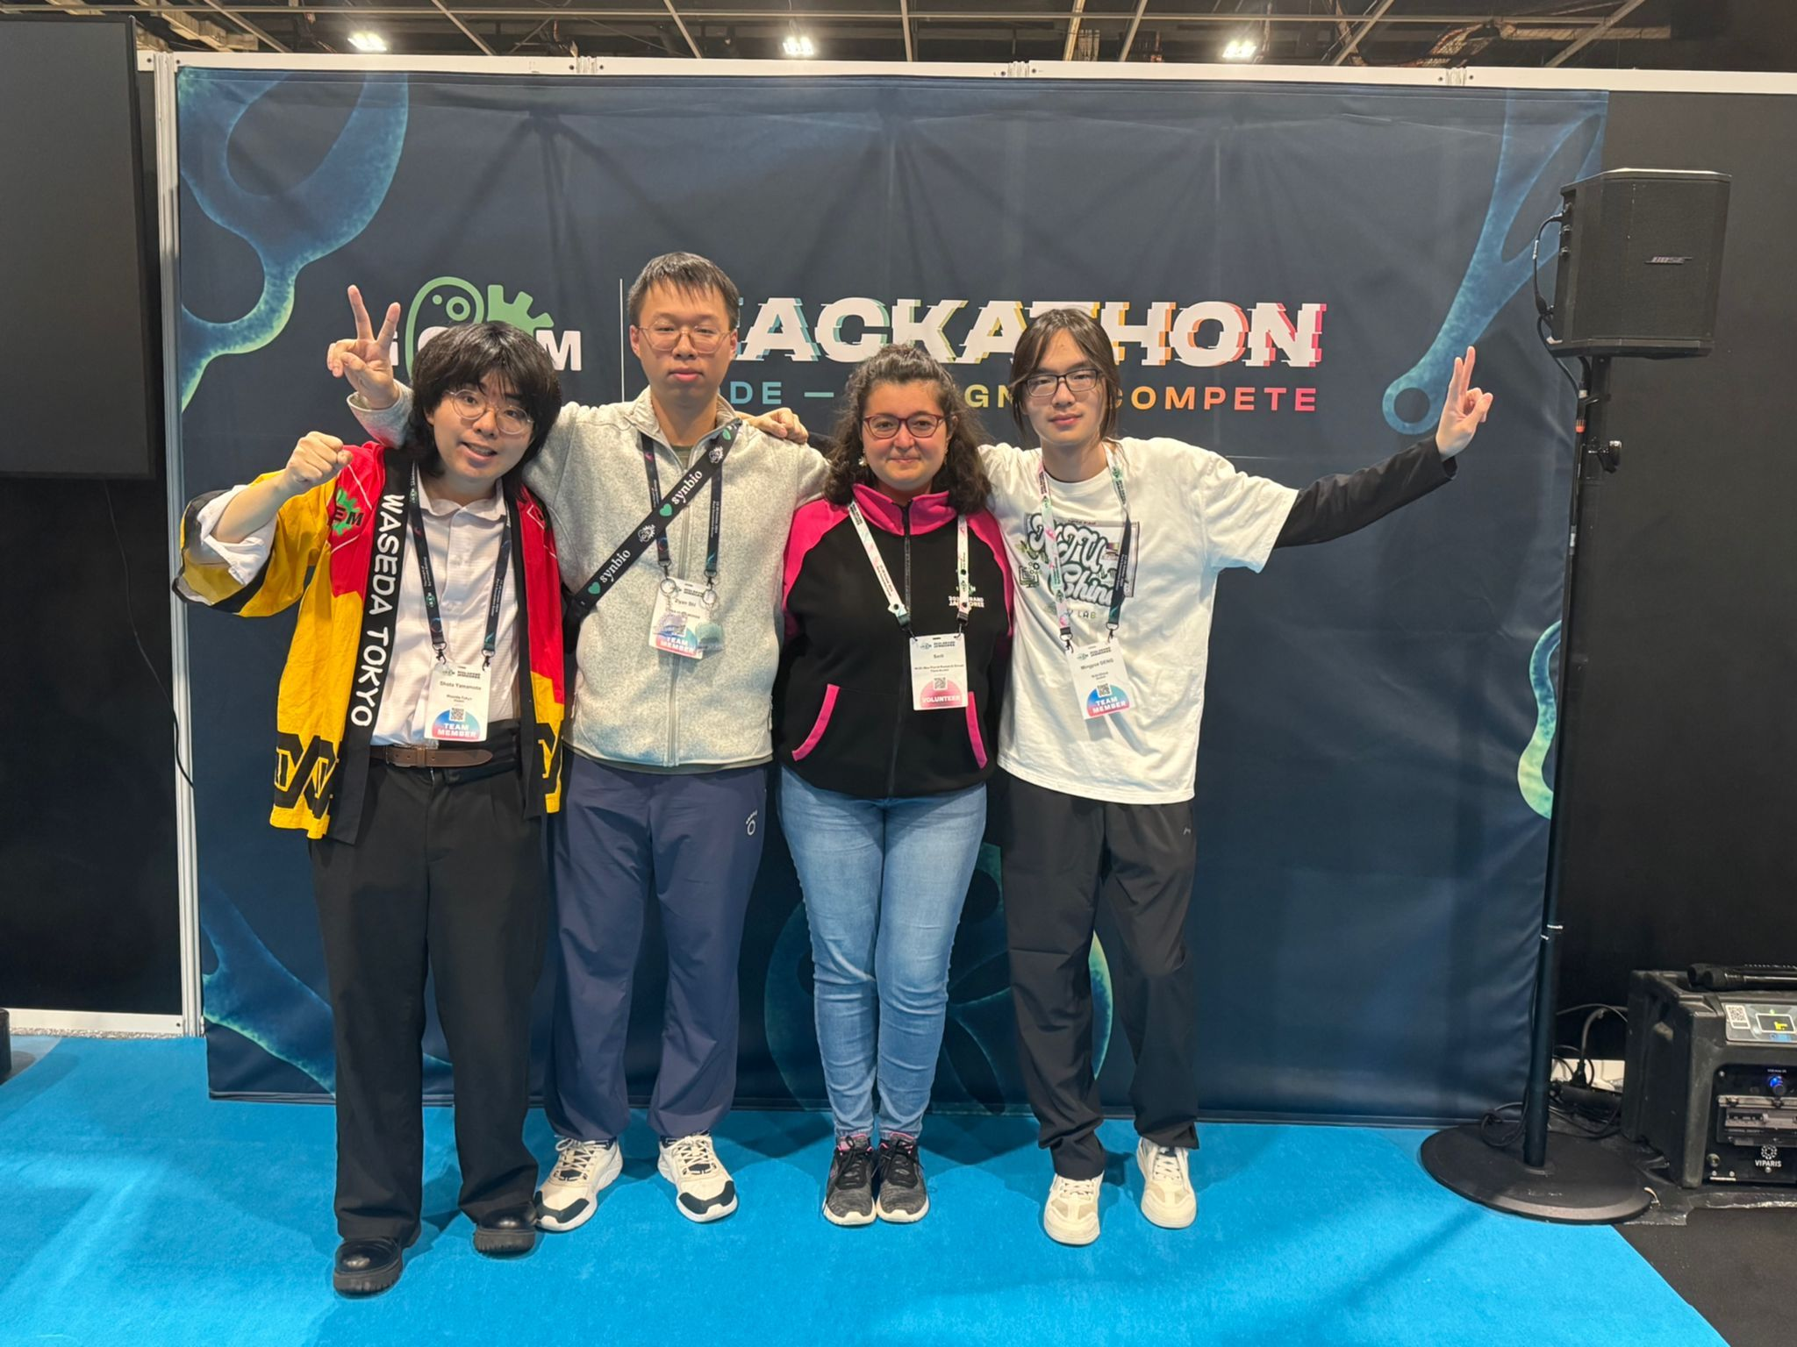
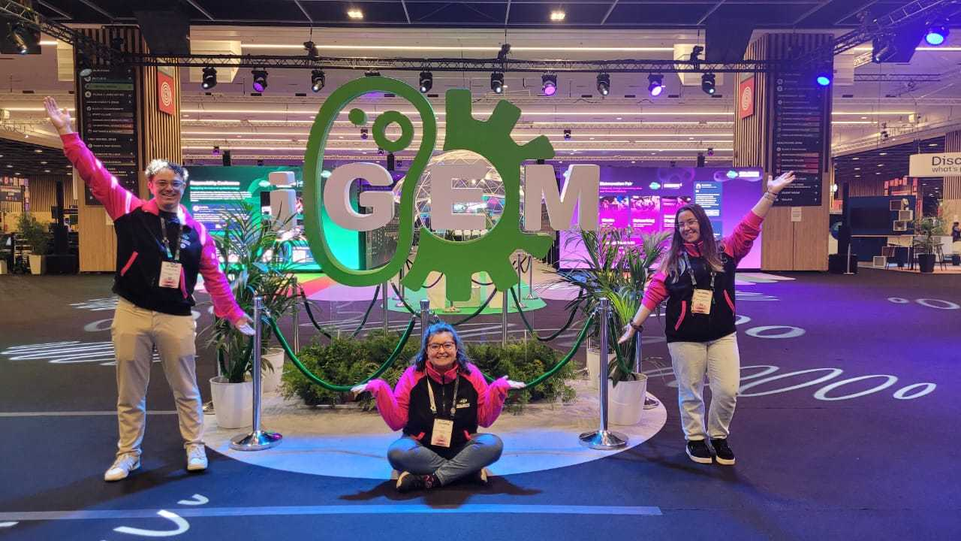
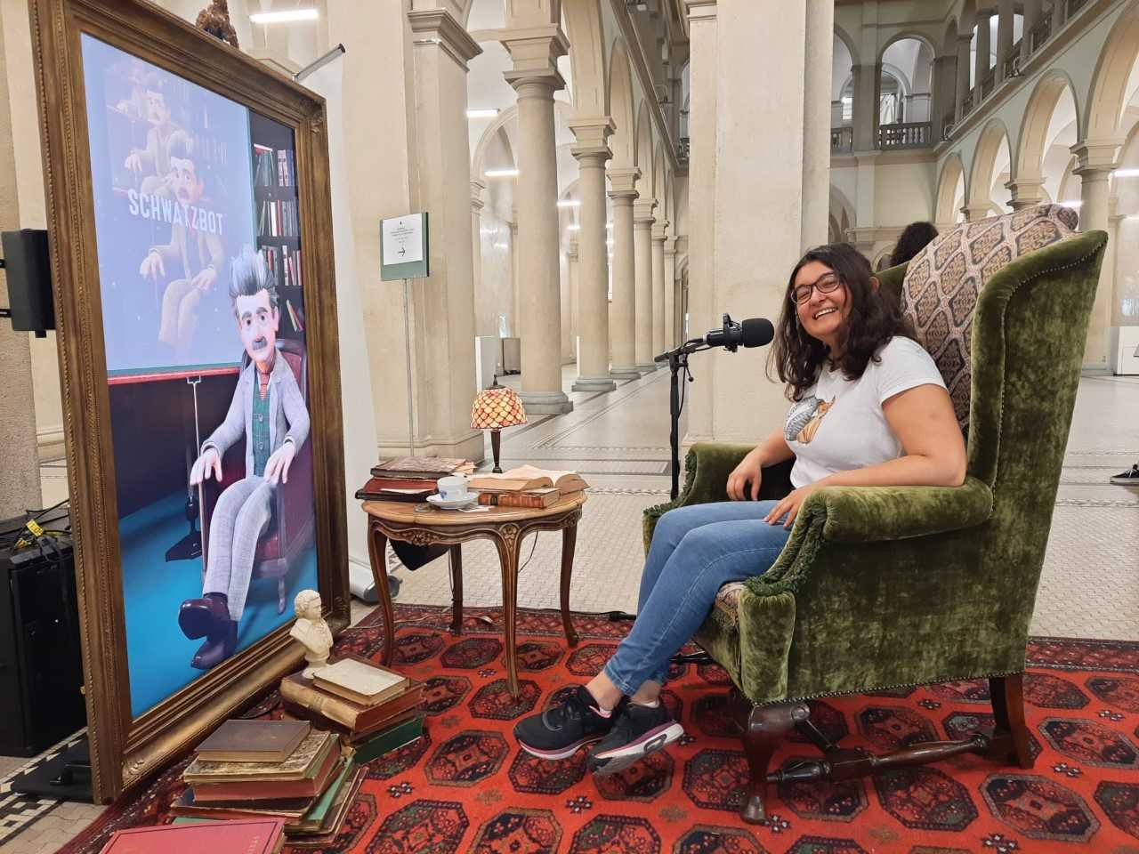
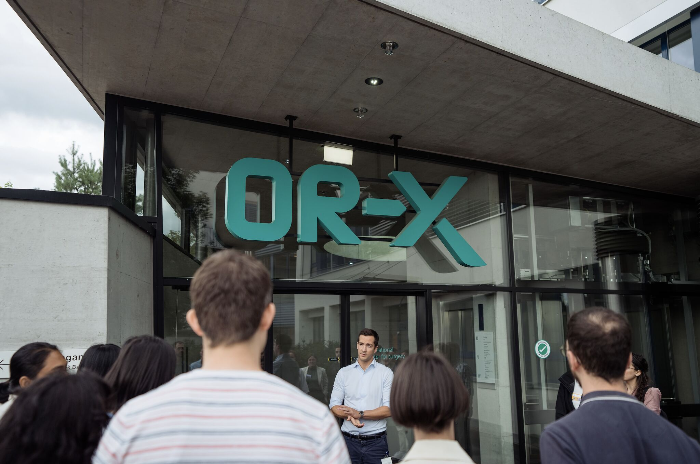
FOKUS Life Sciences m.sc. – CS m.Sc.
I could talk hours and hours about my projects, please do not hesitate to ask ☺

Slide 10
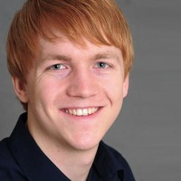
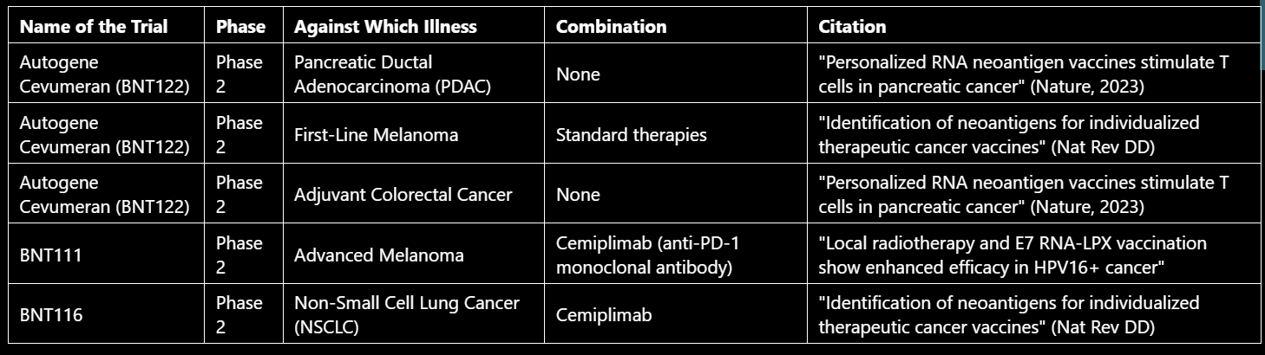
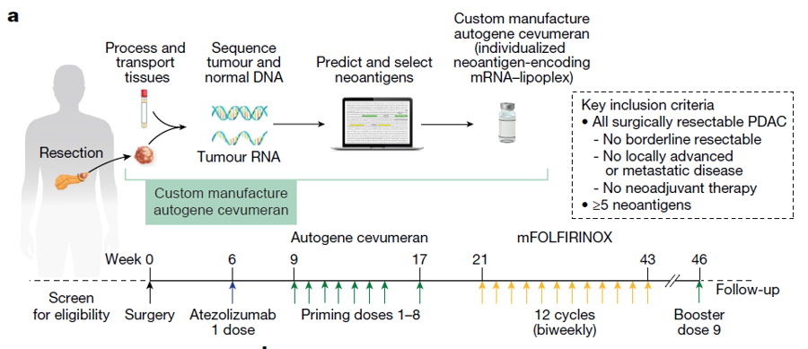
DEMO Project showcase
Meeting 29.11.24: personalised medicine, machine development, sensor-input-analysis
Let’s Code!

Slide 11
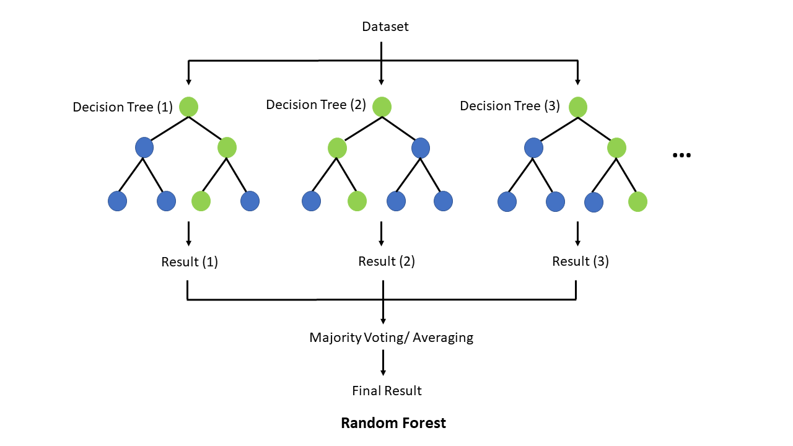
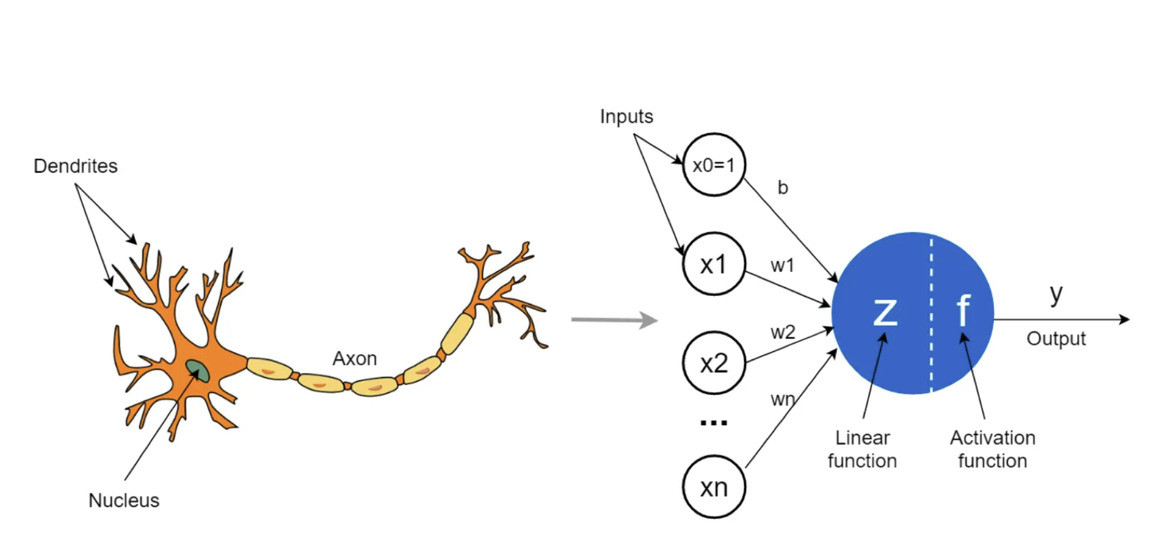
Summary of workflow
Generate synthetic data
EDA
NA values
Histogram
Boxplot
Correlation
Plotting over time
Z-Score Anomaly Calculation
Using these as labels for following models
Simple ML - Random Forest
Using different features for showcasing
Advanced ML – Neural Network
Dashboard Visualisation Tableau

Slide 12
Thank you for listening!
Hope to start working with you soon ☺

